Slide 1

S3
Simple Storage Service
HackTricks Training
https://t.me/CyberFreeCourses

Slide 2
Basic Information
Main AWS service to storage files
Different URLs to access bucket:
<bucketname>.s3.dualstack.aws-region.amazonaws.com
s3.dualstack.aws-region.amazonaws.com/<bucketname>
Multiple options to achieve the protection of data:
Permissions
Open Buckets
Encryption at rest & in transit
Bucket Versioning & MFA based delete
Object Lock
https://t.me/CyberFreeCourses
https://cloud.hacktricks.xyz/pentesting-cloud/aws-pentesting/aws-services/aws-s3-athena-and-glacier-enum

Slide 3
Basic Information: Permissions
Permissions
It’s possible to define permissions via IAM, Resource Policies & ACLs - Resource Policies & ACLs can give access to external accounts.
External accounts cannot overwrite resource policies even if allowed by a resource policy
Object Ownership: There are 2 options about who owns a written object inside a bucket:
Bucket owner: New objects are owned by the bucket owner. This is default and enforced if ACLs are disabled
Object writer: The object writer remains the object owner.
https://t.me/CyberFreeCourses
https://cloud.hacktricks.xyz/pentesting-cloud/aws-pentesting/aws-services/aws-s3-athena-and-glacier-enum

Slide 4
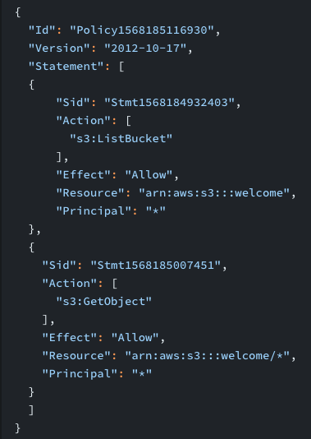
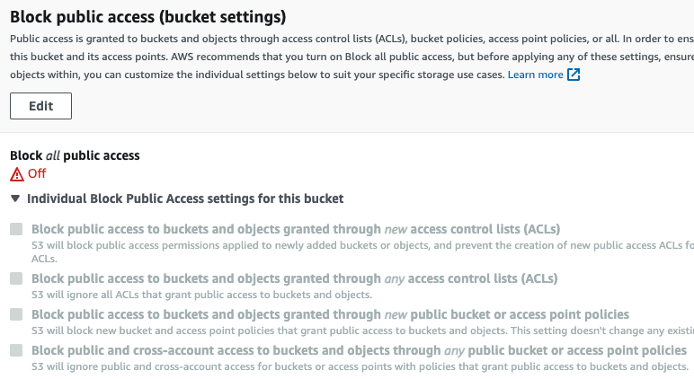
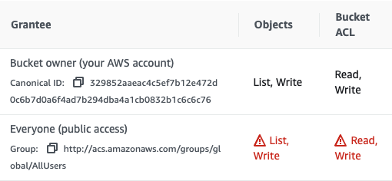
Basic Information: Open Bucket
Probably the most (in)famous vulnerability of Cloud. Now very complicated to misconfigure accidentally.
You need to disable the default blocks, and then explicitly grant access via Resource Policy or ACLs.
https://t.me/CyberFreeCourses
https://cloud.hacktricks.xyz/pentesting-cloud/aws-pentesting/aws-services/aws-s3-athena-and-glacier-enum
Notes:
Create an open bucket with permission to read an change ACLs

Slide 5
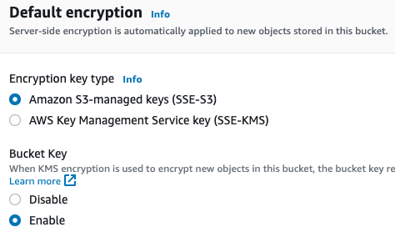
Basic Information: Encryption at Rest - Server Side
Three types of server side encryption are supported:
SSE-S3: Uses AWS managed keys from KMS
SSE-KMS: Uses a Customer Managed Key from KMS
SSE-C: Provide your own master key with the data.
https://t.me/CyberFreeCourses
https://cloud.hacktricks.xyz/pentesting-cloud/aws-pentesting/aws-services/aws-s3-athena-and-glacier-enum

Slide 6
Basic Information: Encryption at Rest - Client Side
Two types of server side encryption are supported. This encryption occurs in the clients machine and the encrypted data is uploaded to AWS:
CSE-KMS: Generate DEKs (Data Encryption Keys), then the data is encrypted and uploaded.
Save encrypted DEK in metadata
CSE-C: Utilize your own provided keys and use an AWS-SDK client to encrypt your data before sending it to S3 for storage.
https://t.me/CyberFreeCourses
https://cloud.hacktricks.xyz/pentesting-cloud/aws-pentesting/aws-services/aws-s3-athena-and-glacier-enum

Slide 7
Basic Information: Encryption in Transit
The goal is to ensure the use of httpS.
The recommended way is to add a policy that ensures that every action performed in the bucket will be made using httpS. For example:
{
"Id": "ExamplePolicy",
"Version": "2012-10-17",
"Statement": [
{
"Sid": "AllowSSLRequestsOnly",
"Action": "s3:*",
"Effect": "Deny",
"Resource": [
"arn:aws:s3:::DOC-EXAMPLE-BUCKET",
"arn:aws:s3:::DOC-EXAMPLE-BUCKET/*"
],
"Condition": {
"Bool": {
"aws:SecureTransport": "false"
}
},
"Principal": "*"
}
]
}
https://t.me/CyberFreeCourses
https://cloud.hacktricks.xyz/pentesting-cloud/aws-pentesting/aws-services/aws-s3-athena-and-glacier-enum

Slide 8
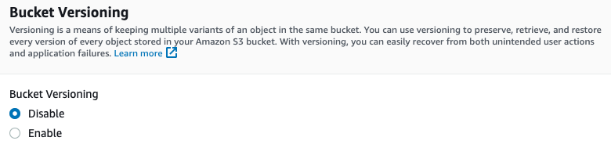
Basic Information: Bucket Versioning & MFA delete
Allows to store multiple versions of an object within the same S3 bucket.
When you upload a new version of an object, S3 automatically archives the previous version, and all versions of an object are stored in the same bucket.
Each version of an object is identified by a unique version ID and retains its own metadata, such as its access control settings and encryption information.
MFA can be enabled to protect Bucket Versioning from being disabled
You will see an alert regarding this in all automated tools
https://t.me/CyberFreeCourses
https://cloud.hacktricks.xyz/pentesting-cloud/aws-pentesting/aws-services/aws-s3-athena-and-glacier-enum

Slide 9
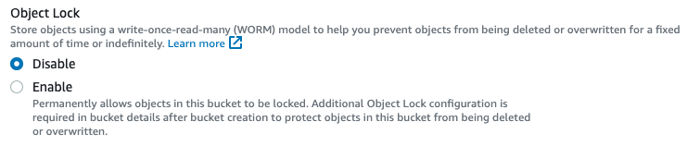
Basic Information: Object Locks
Object Lock is a feature of Amazon S3 that provides immutability protection for objects stored in an S3 bucket.
Objects with Object Lock are protected against deletion and modification, even if an attacker gains access to the AWS root account or the S3 bucket owner's account.
Object Lock provides two modes of protection: "Governance Mode" and "Compliance Mode."
In "Governance Mode," objects are protected against accidental deletion or overwriting for a specified retention period, after which the objects can be deleted.
In "Compliance Mode," objects are protected against deletion and overwriting for an indefinite period, making it ideal for long-term data archiving and retention requirements.
Object Lock can be applied at the time of object creation or later, and the retention period and protection mode can be changed.
To access an object with Object Lock, you must first unlock the object.
https://t.me/CyberFreeCourses
https://cloud.hacktricks.xyz/pentesting-cloud/aws-pentesting/aws-services/aws-s3-athena-and-glacier-enum

Slide 10
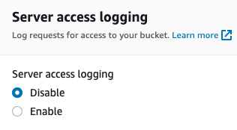
Basic Information: Server Access Logs
S3 Server Access Logging provides detailed records of the requests made to an S3 bucket.
The logs contain information such as the requestor's IP address, request type, response status, and the time and date of the request.
Server Access Logging can be used to monitor and audit the access to your S3 buckets and objects, helping you to keep track of who is accessing your data and when.
S3 Server Access Logging is an important aspect of data security and compliance, as it provides valuable information for auditing and detecting unauthorized access to your data.
You will see an alert regarding this in all automated tools
https://t.me/CyberFreeCourses
https://cloud.hacktricks.xyz/pentesting-cloud/aws-pentesting/aws-services/aws-s3-athena-and-glacier-enum

Slide 11
Manual Enumeration
aws s3 ls # List buckets
aws s3 ls s3://bucket-name --no-sign-request #List bucket as unauthenticated
aws s3 ls s3://bucket-name --recursive #List bucket authenticated
aws s3 cp /tmp/folder/ s3://bucket-name --recursive #Upload local folder
aws s3 sync s3://<bucket>/ . #Download folder
aws s3api get-bucket-acl --bucket <bucket-name> #List ACLs
aws s3api get-object-acl --bucket <bucket-name> --key flag #Get ACL
aws s3api get-bucket-policy --bucket <bucket-name> #Get Policy
aws s3api get-bucket-policy-status --bucket <bucket-name> #if it's public
https://t.me/CyberFreeCourses
https://cloud.hacktricks.xyz/pentesting-cloud/aws-pentesting/aws-services/aws-s3-athena-and-glacier-enum

Slide 12
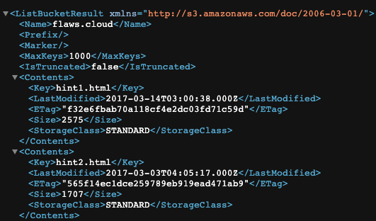
Unauthenticated Access
Search for Open Buckets:
While spidering web pages, search for URLs like s3.amazonaws.com/[bucket_name] or [bucket_name].s3.amazonaws.com.
Or subdomains pointing to something like [bucket_name].s3.amazonaws.com
Bruteforce potential bucket names and check for read, write, change ACLs access
https://github.com/fellchase/flumberboozle/tree/master/flumberbuckets
https://github.com/sa7mon/S3Scanner
https://github.com/jordanpotti/AWSBucketDump
https://github.com/smaranchand/bucky
…
https://github.com/initstring/cloud_enum
Open bucket from: https://flaws.cloud.s3.amazonaws.com/ CTFs to understand buckets better:
http://flaws.cloud/
http://flaws2.cloud/
https://t.me/CyberFreeCourses
https://cloud.hacktricks.xyz/pentesting-cloud/aws-pentesting/aws-unauthenticated-enum-access/aws-s3-unauthenticated-enum

Slide 13
Privilege Escalation
s3:GetBucketAcl, s3:PutBucketAcl
Increase your access to the bucket
s3:GetObjectAcl, s3:PutObjectAcl
Increase your access to an object from the bucket
s3:PutObject, s3:GetObject
Write data and try to privesc in other services
s3:PutBucketPolicy
Only works if in the same account
For more information check https://cloud.hacktricks.xyz/pentesting-cloud/aws-pentesting/aws-privilege-escalation/aws-s3-privesc
https://t.me/CyberFreeCourses

Slide 14
Post Exploitation
Sensitive Information: Sometimes you will be able to find sensitive information in readable in the buckets. For example, terraform state secrets.
Pivoting: Different platforms could be using S3 to store sensitive assets. For example, airflow could be storing DAGs code in there, or web pages could be directly served from S3. An attacker with write permissions could modify the code from the bucket to pivot to other platforms, or takeover accounts.
S3 Ransomware: An attacker that manages to obtain write access in a bucket with Object Versioning disable or unprotected by MFA (so it could be disabled), changes each file for a copy of itself encrypted with a KMS key from his account. Then, he uploads a clear text file to the bucket called something like “ransom-note.txt”, schedules the deletion of the KMS key for 7 days, and if the victim doesn’t pay in time, the date will be lost forever.
For more information check https://cloud.hacktricks.xyz/pentesting-cloud/aws-pentesting/aws-post-exploitation/aws-s3-post-exploitation
https://t.me/CyberFreeCourses

Slide 15
Persistence
Using resource policies and ACLs it’s possible to grant permissions even to principals from other accounts
For more information check: https://cloud.hacktricks.xyz/pentesting-cloud/aws-pentesting/aws-persistence/aws-s3-persistence
https://t.me/CyberFreeCourses

